Slide 1
Movie star kisses and electric shocks: The sign effect in past and future discounting
David J. Hardisty, UBC Sauder
Washington University
Olin Business School
Jan 25, 2019
Notes:
Thanks for having me here, it’s an honor!!!
This talk is actually a combination of two papers. Some of it is stuff that I have been working on for a long time, and some of it is brand new data that nobody has seen before. Both of these papers are in the review process and I would really appreciate your comments, so please interrupt.
You may have noticed “past discounting” in the title…

Slide 2

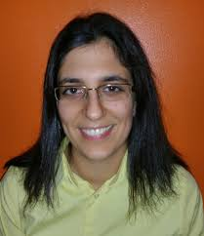
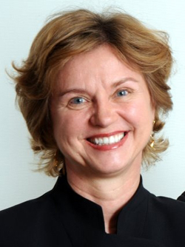
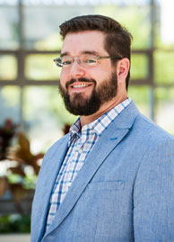
Co-authors
Shane Frederick
Sarah Molouki
Elke Weber
Eugene Caruso

Slide 3

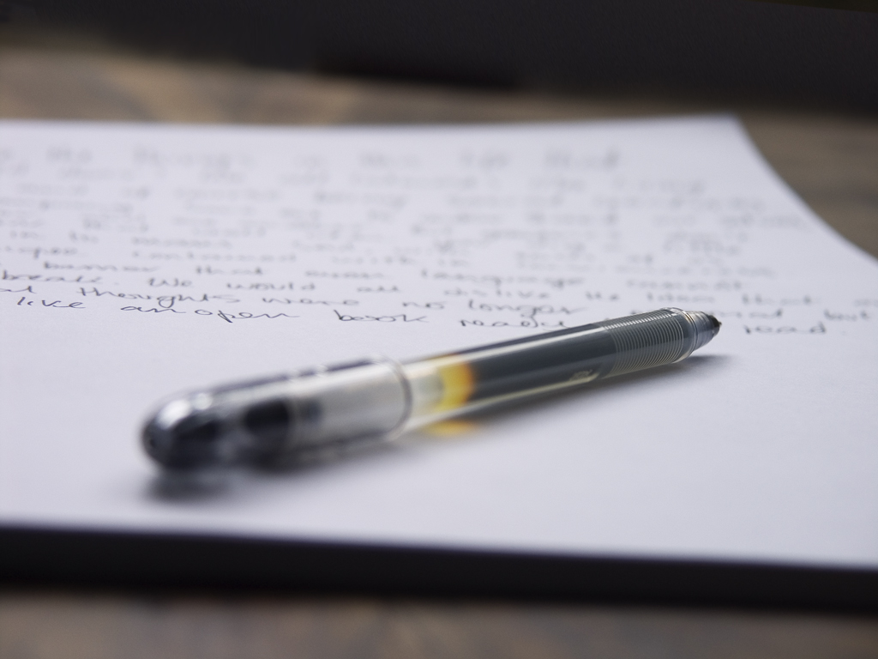
Temporal Discounting
We care less about the future
Good things -> Now
Bad things -> Later
Sign effect:
We want to have good things now more strongly than we want to postpone bad things (Mischel, Grusec, & Masters, 1969; Thaler, 1981; Bilgin & LeBoeuf, 2010)
Notes:
You are on the airplane. Drink cart now or later? Writing letters of recommendation now or later?
Sign effect was first found in Walter Michel’s studies on children, and later formalized by Thaler
image source: https://unsplash.com/

Slide 4
The Sign Effect: Across Domains
Discount rates (Hardisty & Weber, 2009):
Dollar gains: 38%
Environmental gains: 38%
Health gains: 57%
Dollar losses: 7%
Environmental losses: 11%
Health losses: -1%
Notes:
Super robust

Slide 5
What causes the sign effect?
Loss aversion
Vs.
Contemplation utility
(also: time perception and uncertainty)
Notes:
(Also: uncertainty, time perceptions. Probably multiply determined.)

Slide 6
Loss Aversion?
Loss aversion (Tversky & Kahneman 1991):
losses weigh twice as much as gains
(See also : Baumeister et al 2001; Rozin & Royzman 2001)
Magnitude effect (Thaler 1981):
lower discount rates for larger outcomes
Sign effect = loss aversion + magnitude effect?
(Loewenstein & Prelec, 1992; Baucells & Bellezza 2017)

Slide 7
Loss Aversion?
Real choices (unpublished data):
Receive $70 now or $70 in a month?
100% choose now
Pay $70 now or $70 in a month?
47% choose later
Receive $140 now or $140 in a month?
100% choose now
Pay $35 now or $35 in a month?
50% choose later

Slide 8
Contemplation Utility?
We derive pleasure and pain from contemplating future and past events (Loewenstein 1987; Baucells & Bellezza 2017)
Contemplation utility
  Anticipation utility (“savoring”, “dread”, “impatience”)
  Recall utility (“nostalgia”, “elation”, “regret”, “disappointment”)
Lowers discount rates

Slide 9
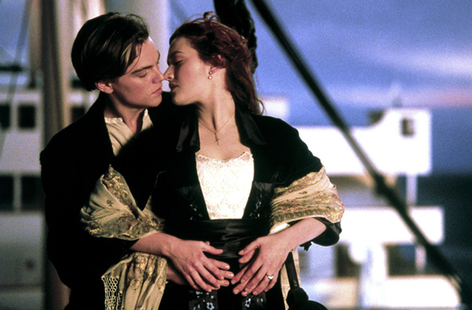
Kiss from a movie star: when?
(Loewenstein, 1987)
“Normal” Discounting -> Now
Contemplation Utility -> Later
Notes:
Image source: https://www.vanityfair.com/hollywood/2017/12/titanic-national-film-registry

Slide 10
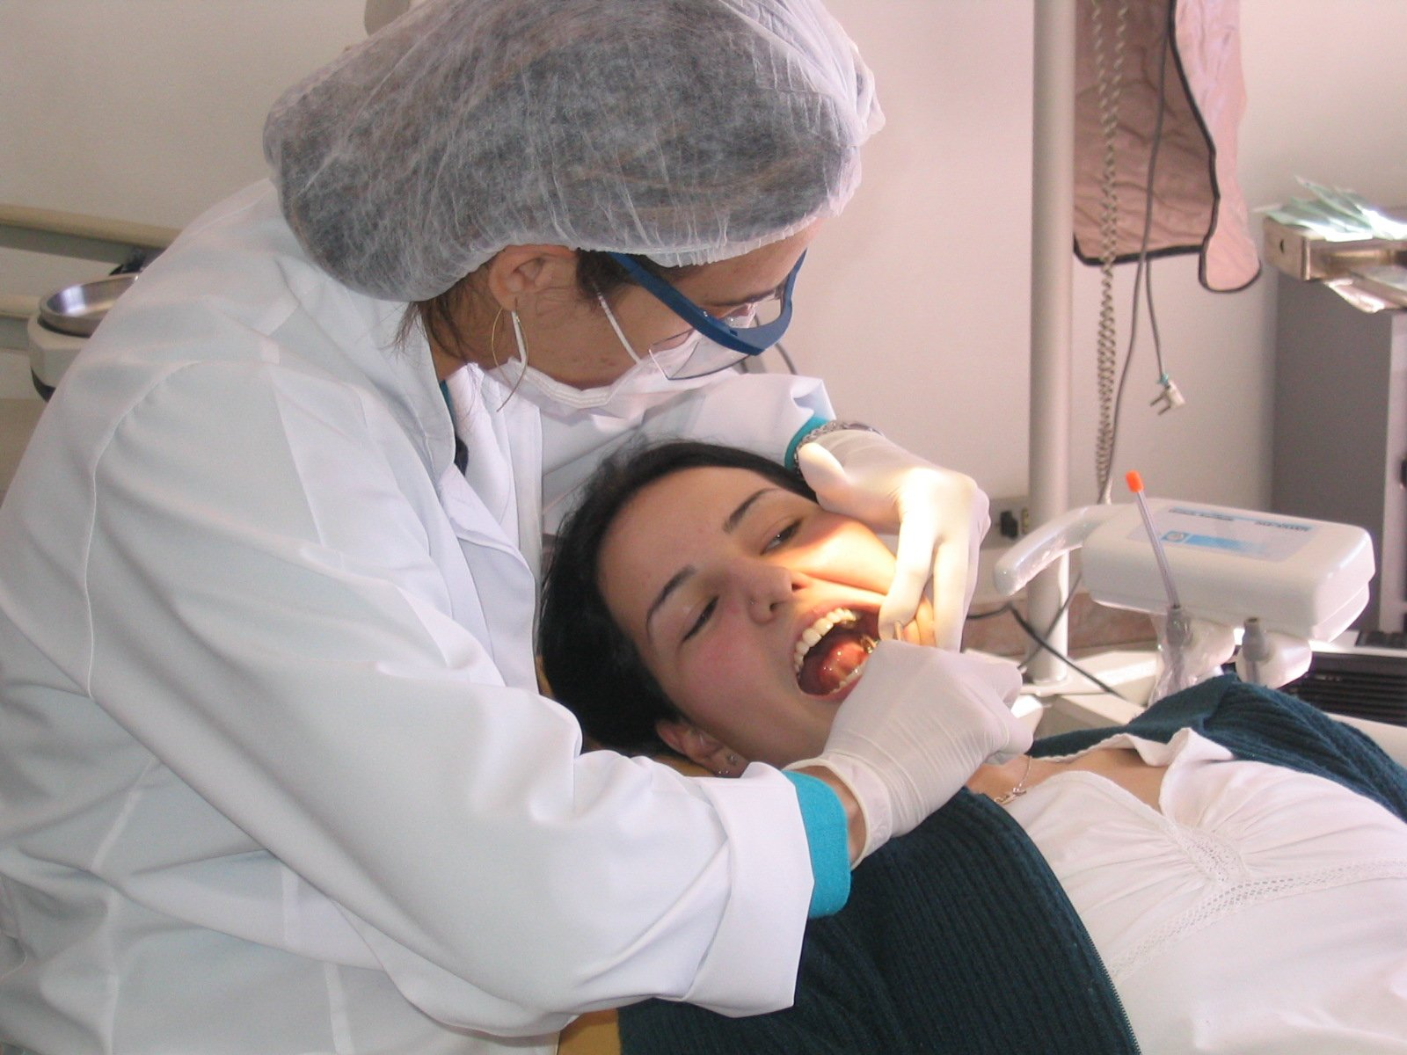
Scheduling a dental procedure
“Normal” Discounting -> Later
Contemplation Utility -> Now
Notes:
Image source: https://unsplash.com/

Slide 11
Contemplation Utility?
Asymmetry
Some evidence for “dread”
(Berns et al 2006; Harris 2012)
Not much evidence for “savoring”
This asymmetry may drive the sign effect

Slide 12
Kiss from a movie star
(Loewenstein 1987; N=30)
Notes:
Error bars show 95% CI

Slide 13
Kiss from a movie star
(Replication; N=206)

Slide 14
Overview
Paper 1:
Contemplation utility and the sign effect in the future
Paper 2:
Compare the future vs the past

Slide 15
Hypotheses
H1: Contemplation of future negatives is stronger and more impactful than contemplation of future positives
H2: Contemplation utility predicts consumer time preferences
H3a: Contemplation utility mediates the sign effect
H3b: Wiping out contemplation utility wipes out the sign effect
H4: When controlling for loss aversion, H1-H3 remain strong
H5: Contemplation of future positive events is a mixed experience, but contemplation of future negative events just feels bad

Slide 16

Study 1: Contemplating payment plans vs rebates
N=200 Mturkers
2 (sign: positive vs negative) x 2 (magnitude: small vs large) between-subjects design
Scenario:
“Imagine that you need to buy a new pair of glasses, and you have narrowed your choice down to two pairs, from two different brands. They are virtually identical in appearance and quality, but they offer different pricing plans.”
Notes:
Image source: https://www.freeimages.com/

Slide 17
Positive condition:
Brand A costs $122. Brand B includes a rebate. It costs $142 now, but you would receive a $30 rebate in the mail after one month. Which would you choose?
Brand A: pay $122 now
Brand B: pay $142 now, and receive $30 in one month
Negative condition:
Brand A includes a payment plan. It costs $122 now, and you would pay an additional bill of $30 after one month. Brand B costs $142. Which would you choose?
Brand A: pay $122 now, and pay $30 in one month
Brand B: pay $142 now

Slide 18
Positive condition:
Brand A costs $61. Brand B includes a rebate. It costs $71 now, but you would receive a $15 rebate in the mail after one month. Which would you choose?
Brand A: pay $61 now
Brand B: pay $71 now, and receive $15 in one month
Negative condition:
Brand A includes a payment plan. It costs $61 now, and you would pay an additional bill of $15 after one month. Brand B costs $71. Which would you choose?
Brand A: pay $61 now, and pay $15 in one month
Brand B: pay $71 now

Slide 19
Experience Utility
Imagine receiving a check for $30 [paying a bill of $30] in one month. Would experiencing this event be pleasurable or displeasurable?
(1=pleasurable, 2=displeasurable)
Imagine receiving a check for $30 [paying a bill of $30] in one month. How strongly would experiencing this event affect your feelings at that time?
(0=Not at all, 50=Strongly, 100=Extremely)
(McGraw et al, 2010)

Slide 20
Contemplation Utility
Imagine expecting to receive a check for $30 [pay a bill of $30] in one month. If this event were one month away, would the anticipation be psychologically pleasurable or displeasurable? In other words, how would you feel while waiting for it?
(1=like the feeling of waiting,
-1=dislike the feeling of waiting)
Imagine expecting to receive a check for $30 [pay a bill of $30] in one month. How strongly would anticipating this event affect your feelings while waiting for the event?
(0=Not at all, 50=Strongly, 100=Extremely)

Slide 21
Unusualness
In your own life, how common are each of the following events?
(0=Extremely rare, 100=Extremely Common)
Receiving around $30
Receiving around $15
Paying around $30
Paying around $15

Slide 22
Study 1: Proportion choosing “impatient” Brand A
 | Rebate | Bill
$15 | 42% | 8%
$30 | 56% | 10%
sign, b=2.11, SE=0.59, Wald χ²(1)=12.69, p<.001
magnitude, b=0.25, SE=0.70, Wald χ²(1)=0.12, p=.73
interaction, b=0.31, SE=0.81, Wald χ²(1)=0.14, p=.71

Slide 23
Study 1: Contemplation Utility
Mediation: Sign->Contemplation->Brand Choice b=.38, SE=.14, CI₉₅ [.17, .74]

Slide 24
Study 1: Controlling for Loss Aversion
Method 1: include experience utility in the analyses, all key tests remain significant, p=.001 or lower
Method 2: compare $15 bill condition with the $30 rebate condition , all key tests remain significant, p=.002 or lower

Slide 25
Study 1: Commonness
Small bills were judged to be more common than receiving small amounts of money
More common things were contemplated slightly more strongly, r=.14, p=.05
Commonness did not predict time preferences

Slide 26
Study 1: Summary & Discussion
Consumers care about future payments more than future rebates
Contemplation of losses is negative, contemplation of gains near zero
Contemplation predicts choices
  Even when controlling for loss aversion
Self-report can be unreliable
  Let’s manipulate contemplation, and measure real behavior

Slide 27

Study 2: Contemplating Retirement

Slide 28
Study 2: Facebook Field Study
Facebook allows AB Testing!
Advertisement Design:
2 (sign: pos vs neg) x 2 (contemplation message: absent vs present)
Budget: $50 per ad over 5 days total.
N (“reach”) = 28,568
DVs:
  click-through-rate (CTR)
  cost per click
Notes:
For facebook ads: there are some constraints of course. Also: make sure the ad score is the same in each conditions

Slide 29
Study 2: Facebook Settings
age 19-64
location Canada
language English
all devices
bid cap $1
optimization: link clicks
bid strategy: lowest cost

Slide 30
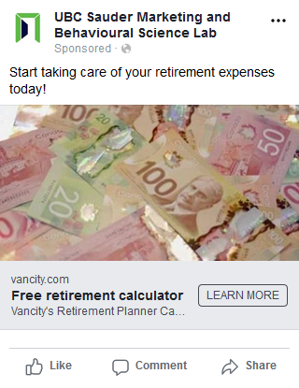
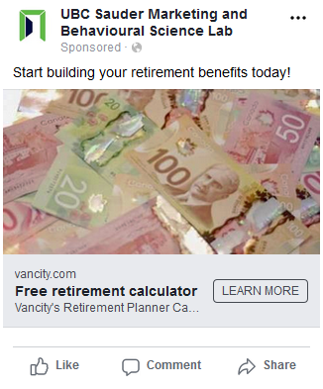
Study 2: contemplation msg absent

Slide 31
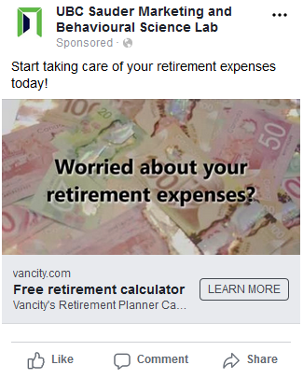
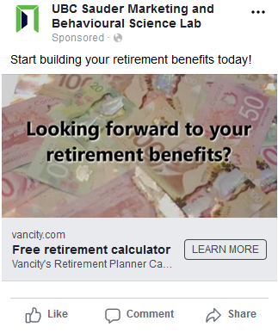
Study 2: contemplation msg present

Slide 32
Study 2: Facebook Results (CTR)
 | Positive Frame | Negative Frame
Contemplation msg absent | 1.84% | 2.03%
Contemplation msg present | 2.58% | 3.63%

Slide 33
Study 2: Facebook Results (CPC)
 | Positive Frame | Negative Frame
Contemplation msg absent | $0.30 | $0.31
Contemplation msg present | $0.25 | $0.18

Slide 34
Study 2: Summary
Consumers care about future retirement expenses more than future retirement benefits
This is especially true when contemplation is emphasized

Slide 35
Study 3: Controlling for Loss Aversion
106 participants from Amazon MTurk
Dynamically identify subjectively equivalent gains and losses for each subject
Compare anticipation for these subjectively equivalent pairs

Slide 36
Accept this pair of events?
50% chance of receiving 25 dollars
AND
50% chance of paying 25 dollars
Yes Unsure No

Slide 37
Accept this pair of events?
50% chance of receiving 500 dollars
AND
50% chance of paying 25 dollars
Yes Unsure No

Slide 38
Accept this pair of events?
50% chance of receiving 49 dollars
AND
50% chance of paying 25 dollars
Yes Unsure No

Slide 39
Study 3: Stimulus
Please consider the following event:
[50% chance of receiving $49]
Assuming this event would definitely happen to you and you knew it were coming, when would you prefer it to happen?
Immediately OR in one week

Slide 40
Study 3: Stimulus
Please consider the following event:
[50% chance of paying $25]
Assuming this event would definitely happen to you and you knew it were coming, when would you prefer it to happen?
Immediately OR in one week

Slide 41
Study 3: Stimulus
Please consider the following event:
[get a free, relaxing massage for 50 minutes]
Assuming this event would definitely happen to you and you knew it were coming, when would you prefer it to happen?
Immediately OR in one week

Slide 42
Study 3: Stimulus
Please consider the following event:
[spend time stuck in horrible traffic for 45 minutes]
Assuming this event would definitely happen to you and you knew it were coming, when would you prefer it to happen?
Immediately OR in one week

Slide 43
Study 3: Stimulus
Please consider the following event:
[a complimentary dinner at a restaurant of your choice]
Assuming this event would definitely happen to you and you knew it were coming, when would you prefer it to happen?
Immediately OR in one week

Slide 44
Study 3: Stimulus
Please consider the following event:
[endure 10 mild (and harmless) electric shocks]
Assuming this event would definitely happen to you and you knew it were coming, when would you prefer it to happen?
Immediately OR in one week

Slide 45
Time preferences
 | Gains | Losses
Now | 79% | 57%
In one week | 21% | 43%

Slide 46
Time preferences
 | Gains | Losses
Now | 79% | 57%
In one week | 21% | 43%

Slide 47
Study 3: Stimulus
2.a. Please imagine this event happening one week from now. Would experiencing this event be pleasurable or unpleasurable?
Pleasurable experience OR unpleasurable experience
2.b. How strongly would experiencing this event affect your feelings at that time?
not at all strongly extremely
|--------------------------------------------------------------------------|
(Wording based on McGraw et al, 2010)

Slide 48
Study 3: Stimulus
3.a. If this event were one week away, would the anticipation be psychologically pleasurable or unpleasurable? In other words, how would you feel while waiting for it?
Like the feeling of waiting OR Dislike the feeling of waiting
3.b. How strongly would anticipating this event affect your feelings while waiting for the event?
not at all strongly extremely
|--------------------------------------------------------------------------|

Slide 49
Utility for experience and anticipation

Slide 50
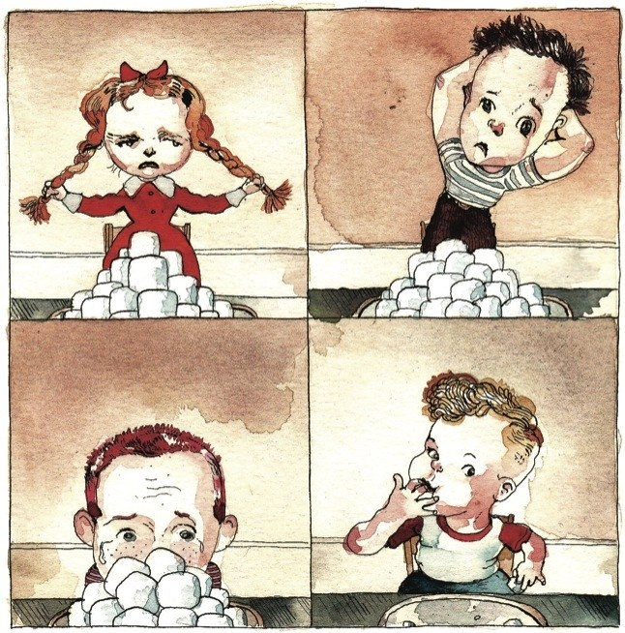
Study 4: Why asymmetric?
Hypothesis
We enjoy contemplating future gains
We dislike contemplating future gains
We dislike contemplating future losses
BUT: We rarely enjoy contemplating future losses
Notes:
Image source: Children who are able to pass the marshmallow test enjoy greater success as adults.Illustration by Barry Blitt
https://www.newyorker.com/magazine/2009/05/18/dont-2

Slide 51
Study 4: Methods
105 participants from Amazon MTurk
10 positive & 10 negative events
Time preference
Two questions for anticipation:
…how pleasurable or happy would the anticipation be?
…how displeasurable or unhappy would the anticipation be?

Slide 52
Study 4 Results

Slide 53
Study 5: Contemplating Jellybeans
Perhaps contemplation of real events is different in important ways
2nd goal: Rule out demand characteristics
How can we give matched positive and negative experiences in the lab?

Slide 54
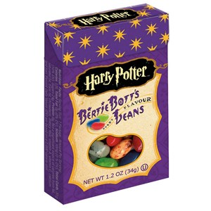
Study 5: Methods
Randomly assigned to “Dirt” or “Toasted marshmallow” flavor jellybean (pretested)
(Jellybeans visible in the experimental room)
Everyone must wait one week to eat the jellybean
Rated predicted experience utility
and anticipation utility
Notes:
Story here about attempting shocks and massages
Image source: https://www.delish.com/food-news/g3576/childhood-candies-you-forgot-you-were-obsessed-with/?slide=1

Slide 56
Study 6: Eliminating contemplation
Wiping out contemplation should wipe out the sign effect
Design: 2 (pos vs neg) x 2 (choose for self vs other) between subjects, N=175 undergraduates
Jellybean flavors:
Glazed Blueberry Cake (Good-tasting with sweet aftertaste)
French Vanilla (Good-tasting with sweet aftertaste)
Soap (Bad-tasting, soapy flavor with sweet aftertaste)
Black Pepper (Bad-tasting, spicy flavor with sweet aftertaste)
Notes:
Image source: https://www.freeimages.com/

Slide 57
Study 6: choosing “immediately”
 | Good Flavor | Bad Flavor
Choose for self | 73% | 81%
Choose for other | 58% | 58%

Slide 58
Study 6: “discounting”
 | Good Flavor | Bad Flavor
Choose for self | 73% | 19%
Choose for other | 58% | 42%

Slide 59
Study 7: Exploring Contemplation
Why is contemplation mixed for gains and unipolar
for losses?
Mturkers (N=100) will see photos of puppies or cockroaches
How certain are you that you will see these photos?
How certain are you about how you will react to the photos?
Please consider your uncertainty about the photos. How does the uncertainty make you feel?
When you think about the photos, do you feel like in some sense, they belong to you? In other words, that they are your due?
Notes:
Image source: https://www.freeimages.com/

Slide 60
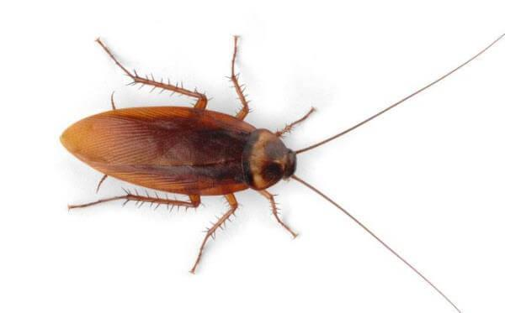
Notes:
Image source: https://isotechpest.com/pest-info/cockroaches/american-cockroach

Slide 61
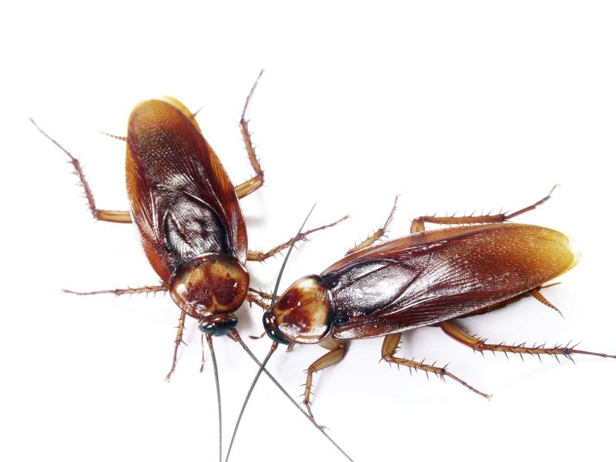
Notes:
Image source: https://allencountyhealth.com/info-about/environmental-health/healthy-homes/pest-control/cockroaches

Slide 62
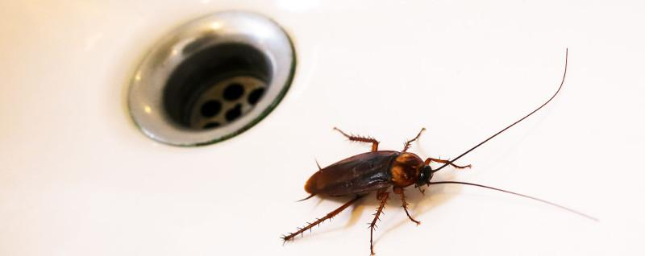
Notes:
Image source: iStock

Slide 63
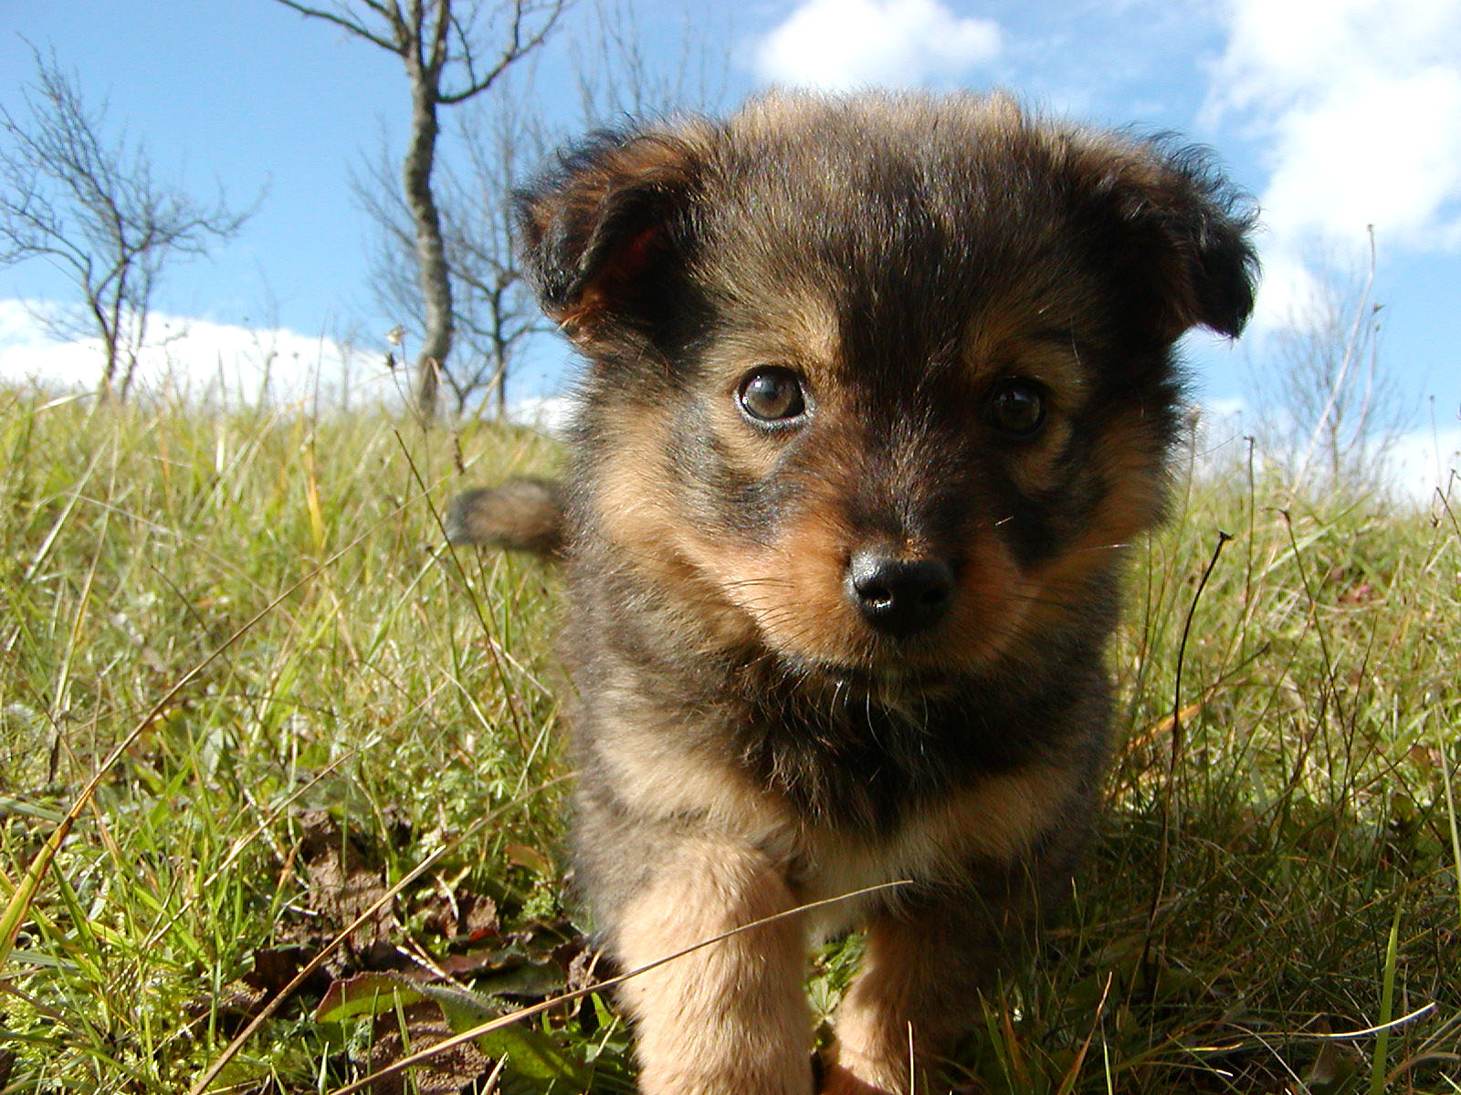
Notes:
Image source: https://unsplash.com/

Slide 64
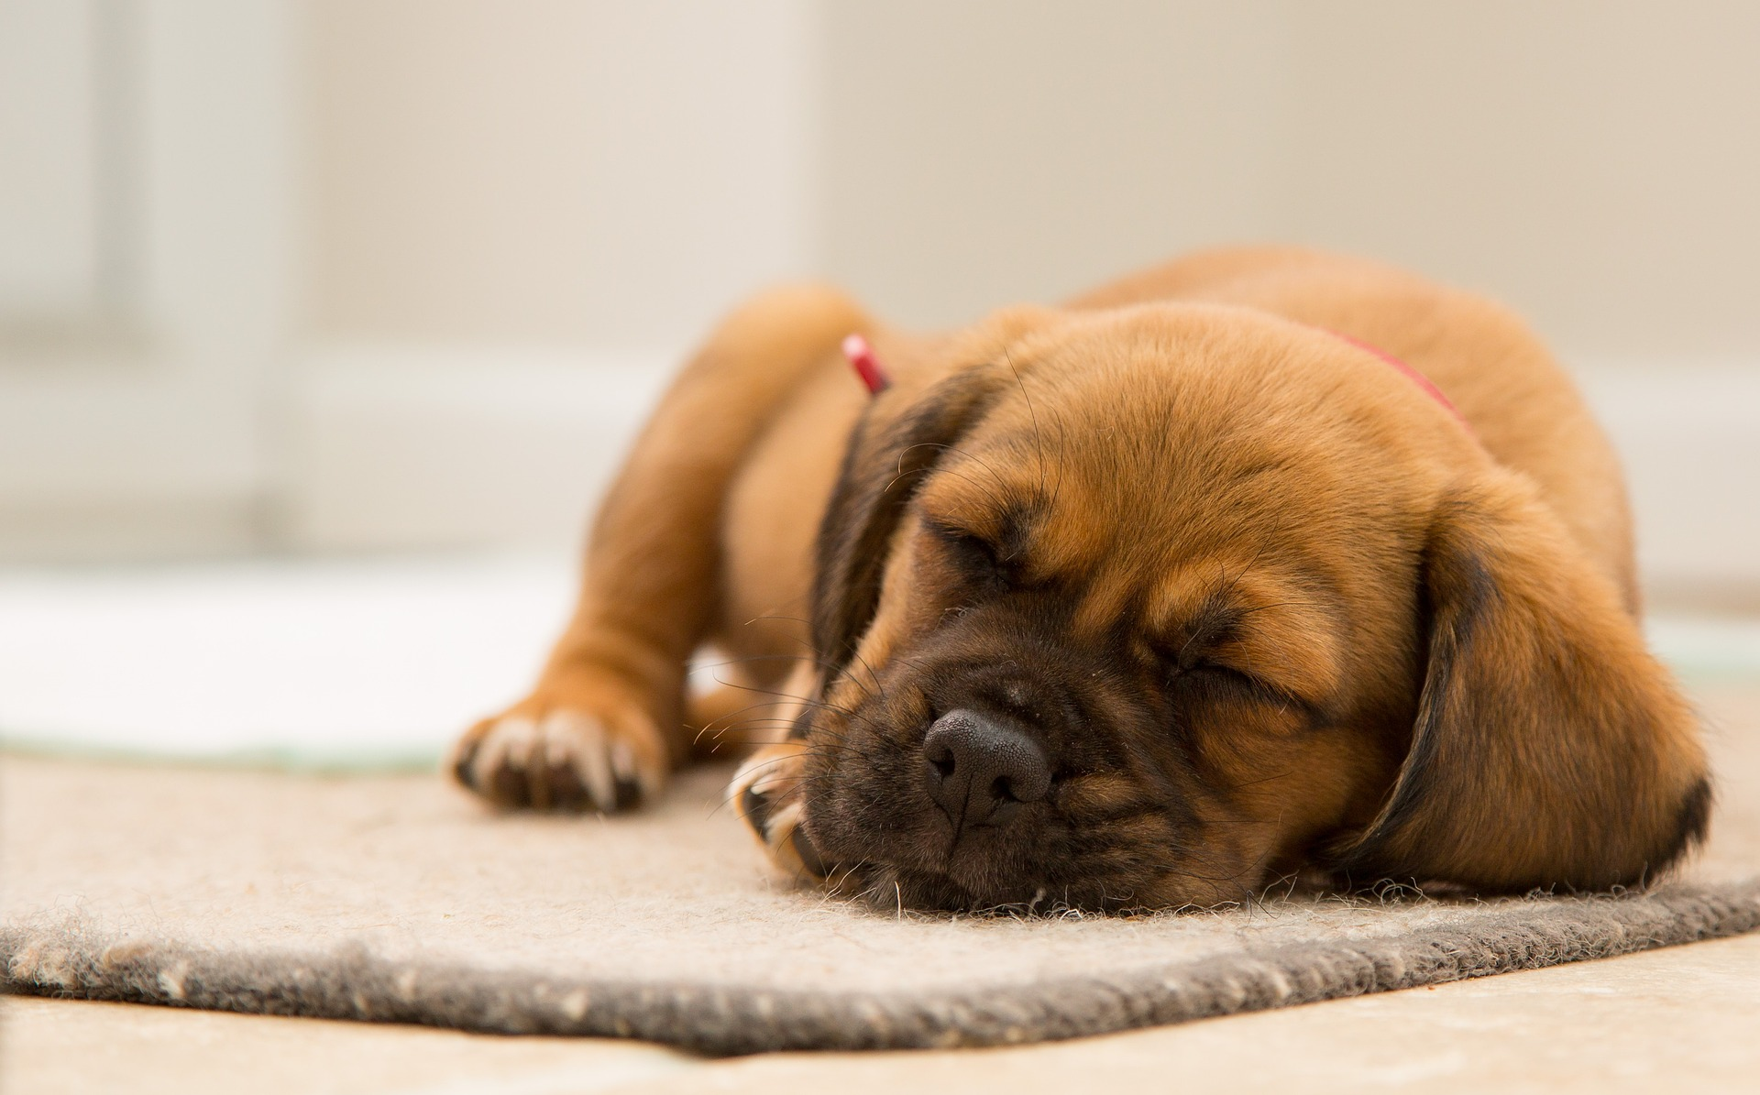
Notes:
Image source: https://unsplash.com/

Slide 65
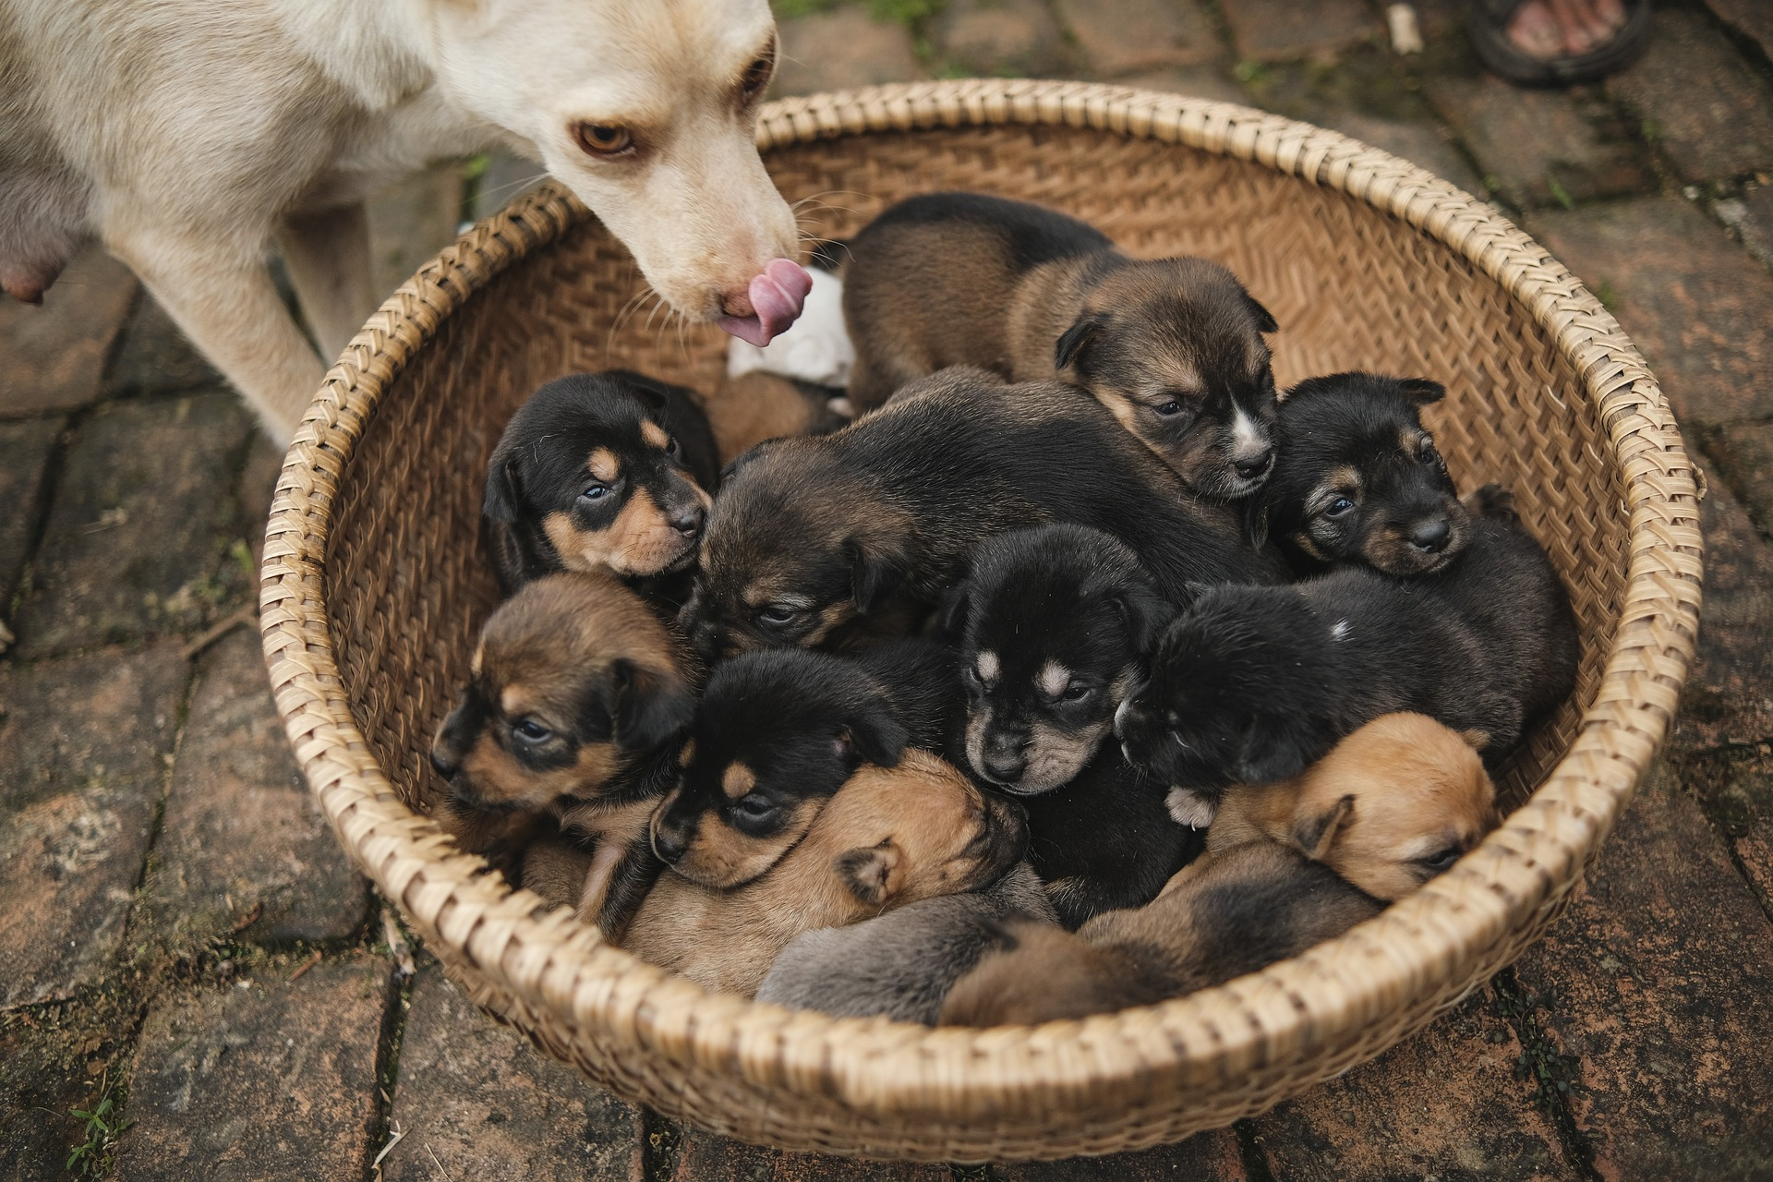
Notes:
Image source: https://unsplash.com/

Slide 66
Study 7: Results Summary
People dislike feelings of uncertainty about future puppies AND future cockroaches
Feelings about uncertainty are strongly correlated with contemplation utility,
r = .51, p < .001
People feel are more prone to feel endowed with future puppies than future cockroaches
Mental endowment correlated with contemplation utility (reverse scored for losses)
r = -.30, p < .01

Slide 67
Paper 2: The sign effect in past and future discounting

Slide 68
Paper 2: Future vs Past,
A critical test of the sign effect
We discount past events, even more than future events (Caruso, Gilbert, & Wilson, 2008)
Sign effect in the past?
Loss aversion account:
Sign effect should be the same in the past
Contemplation account:
Sign effect should be reduced or eliminated in the past

Slide 69
Overview
Study 1: Discounting and contemplation of hypothetical events
Study 2: Contemplation of real jellybeans
Study 3 (summary): Fancier version of Study 1
Study 4 (if time): The role of uncertainty

Slide 70
Study 1a
Sign x Tense with money

Slide 71
Study 1a: Methods
184 Mturkers
2 (gain vs loss) x 2 (future vs past)
Within subjects, counterbalanced
Gains (~$10) twice as big as losses (~$5)

Slide 72
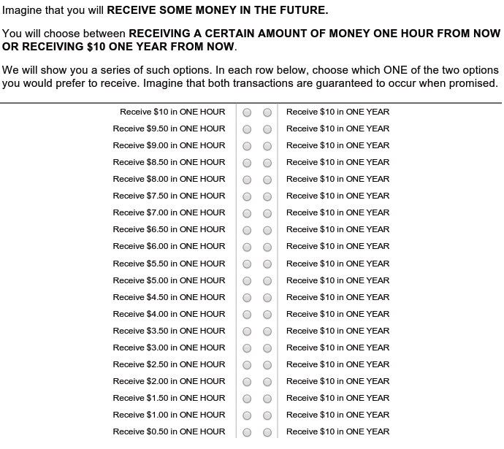

Slide 73
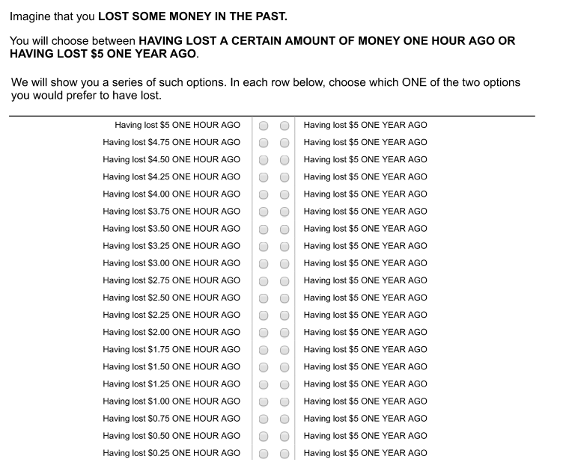

Slide 74
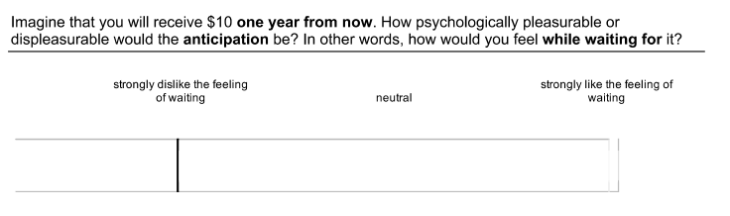
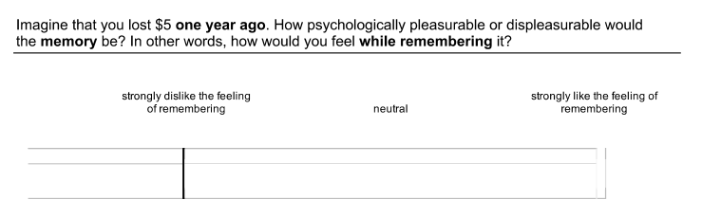
Study 1a: Contemplation Utility

Slide 75
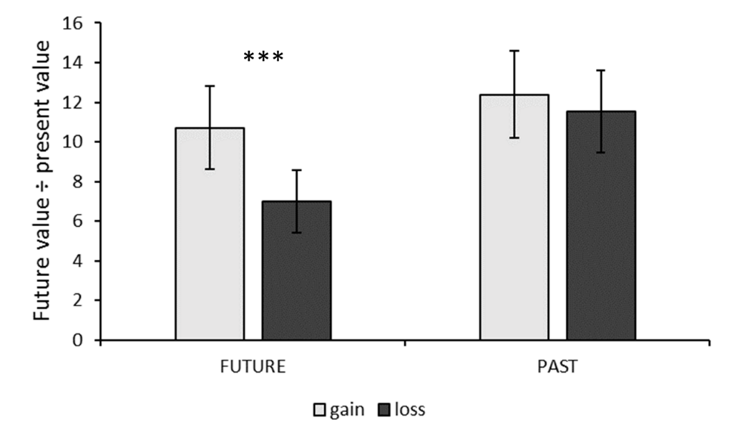
Study 1a: Discounting Results

Slide 76
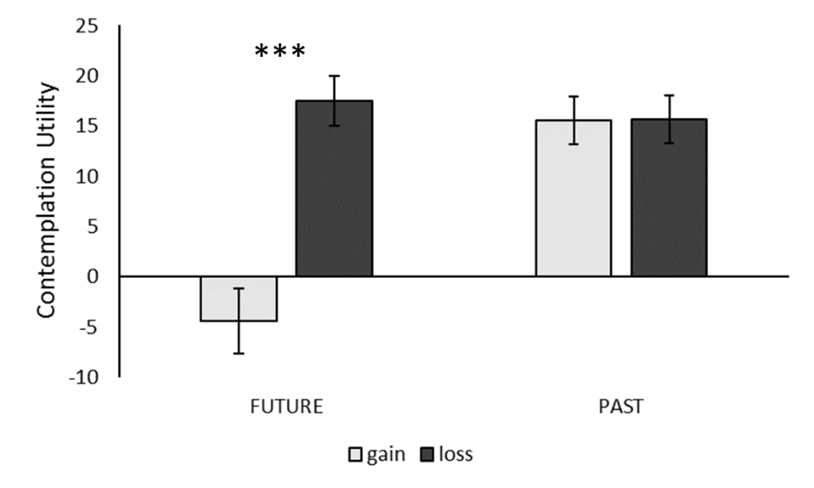
Study 1a: Contemplation Utility Results

Slide 77
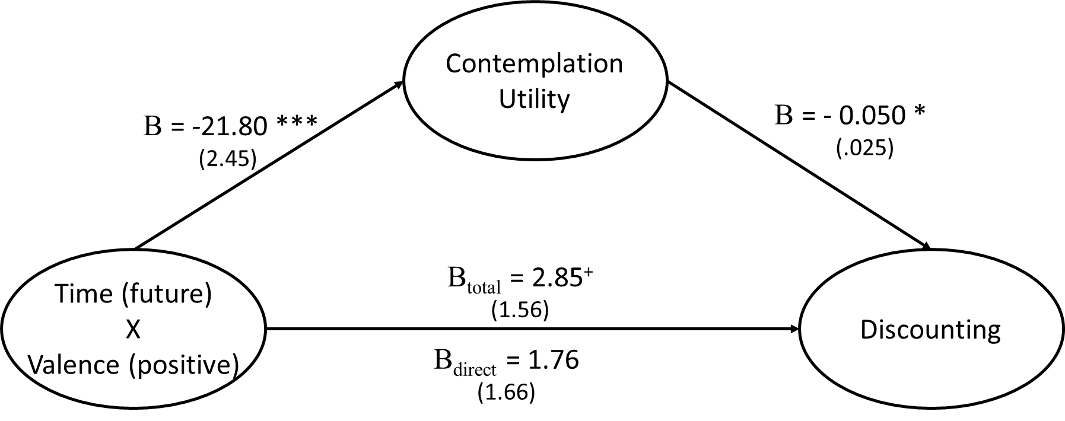
Study 1a: Mediation

Slide 78
Study 1b
Sign x Tense with hedonic events

Slide 79
Study 1b: Methods
186 Mturkers
Same design as Study 1a
Stimuli:
Pos: receiving a pleasant 1 hour massage
Neg: receiving an unpleasant (but non-harmful) 1 minute electric shock

Slide 80
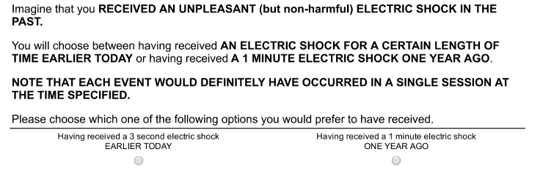
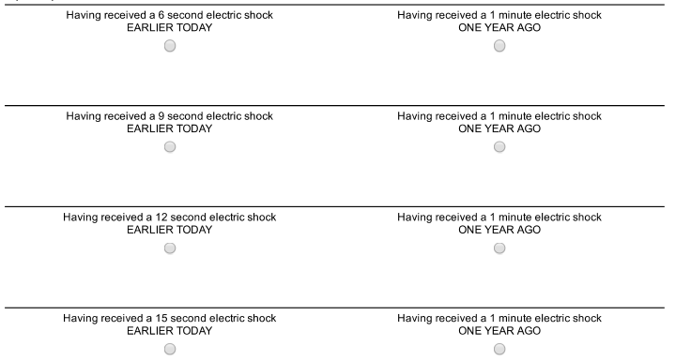

Slide 81
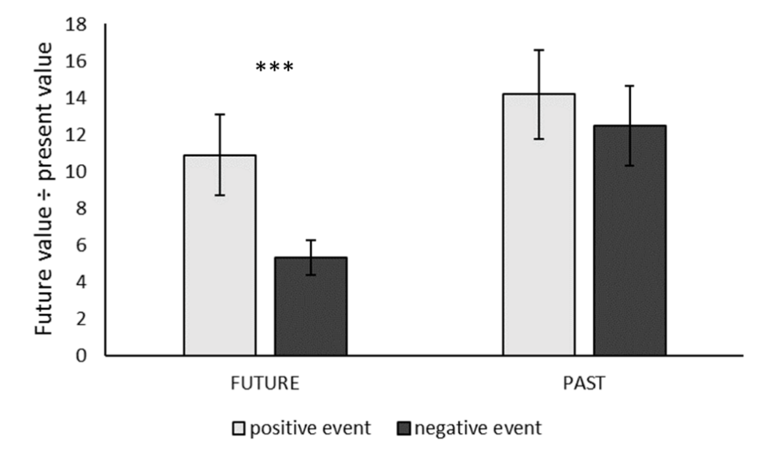
Study 1b: Discounting

Slide 82
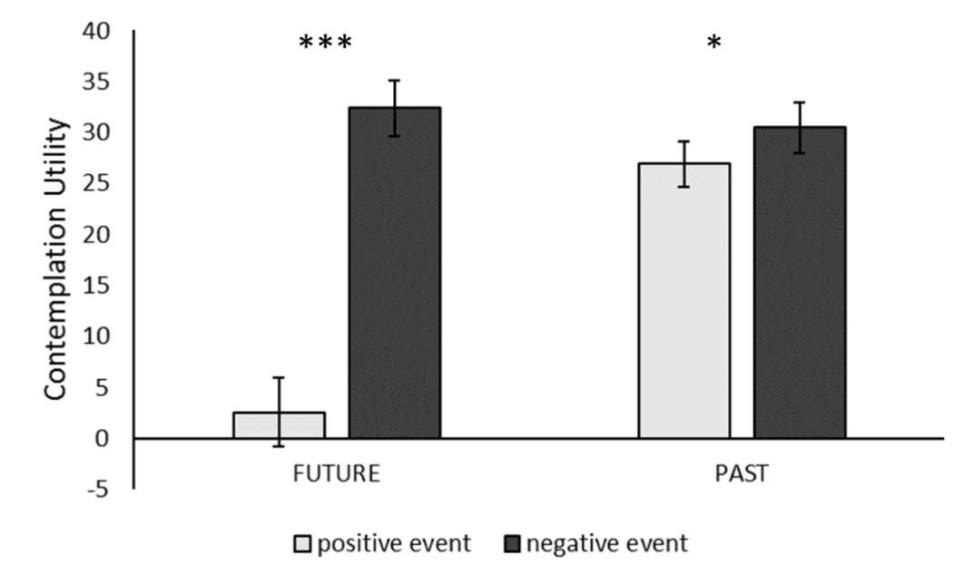
Study 1b: Contemplation utility

Slide 83
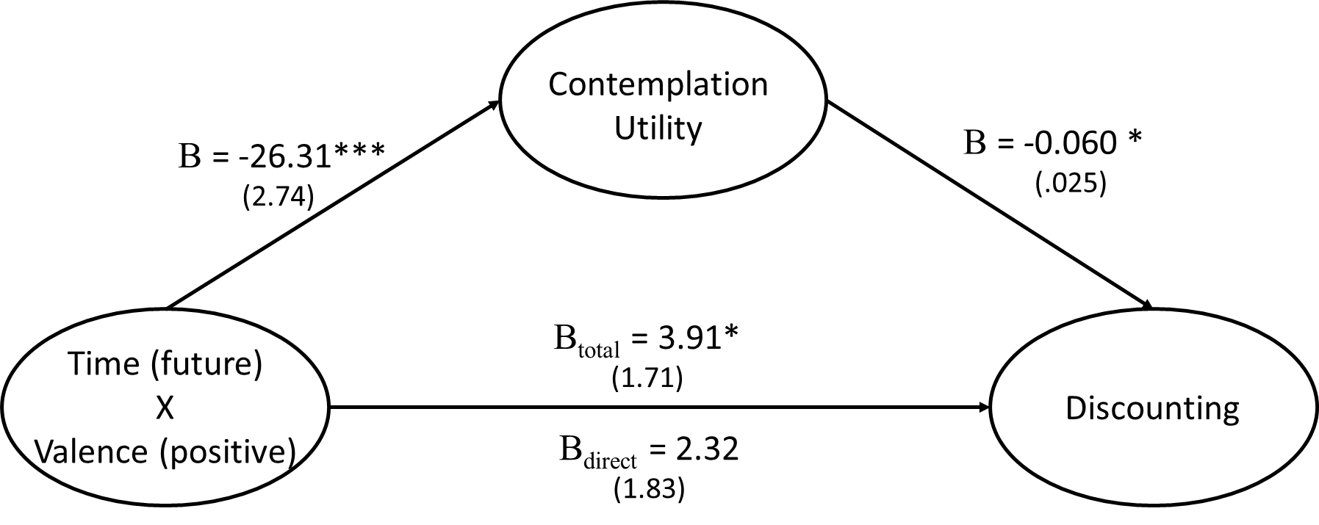
Study 1b: Mediation

Slide 84
Study 1: Discussion
Sign effect eliminated in past discounting
Contemplation utility:
  shows a similar pattern
  Mediates the sign X tense interaction
Study 2:
Real outcomes
Rule out demand/consistency effects
Why is contemplation utility of future gains so low?
  Contemplation of future positives is a mixed experience
  Contemplation of other events is unipolar

Slide 85
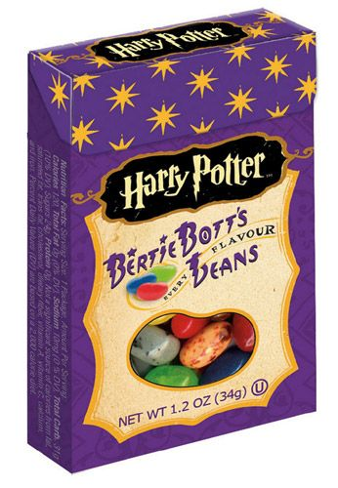
Study 2: Real Events
Notes:
Story here about attempting shocks and massages
Image source: https://www.delish.com/food-news/g3576/childhood-candies-you-forgot-you-were-obsessed-with/?slide=1

Slide 86
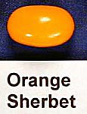
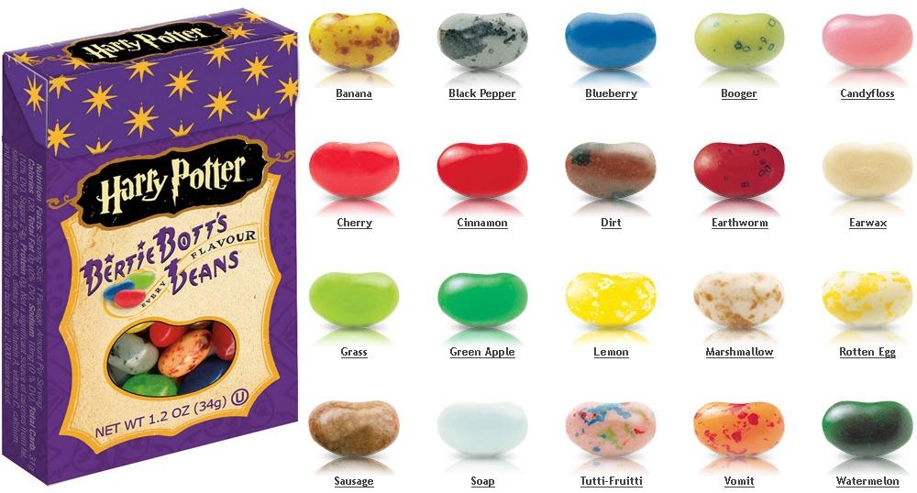
Study 2: Stimuli
Notes:
Story here about attempting shocks and massages
Image source: https://www.delish.com/food-news/g3576/childhood-candies-you-forgot-you-were-obsessed-with/?slide=1

Slide 87
Study 2: Methods
100 university students
2x3 design:
Flavor: pos vs neg, between subjects
Time: future vs present vs past, within subjects:
T1: Predicted experience and current anticipation
15 minutes filler tasks
T2: Rate experience
15 minutes filler
T3: Remembered experience and current recall utility

Slide 88
Study 2: Methods T1
The flavor you have been assigned to is:
dirt_____
15 minutes from now, you will be eating this jelly bean.

Slide 89
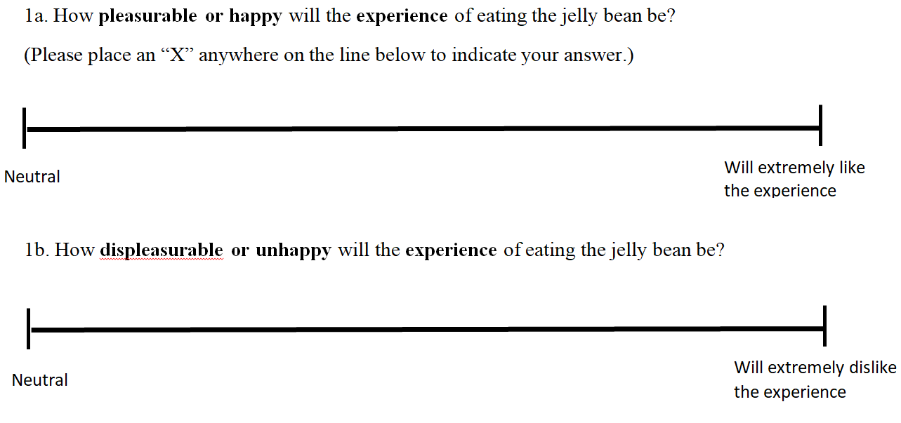
T1 Experience prediction

Slide 90
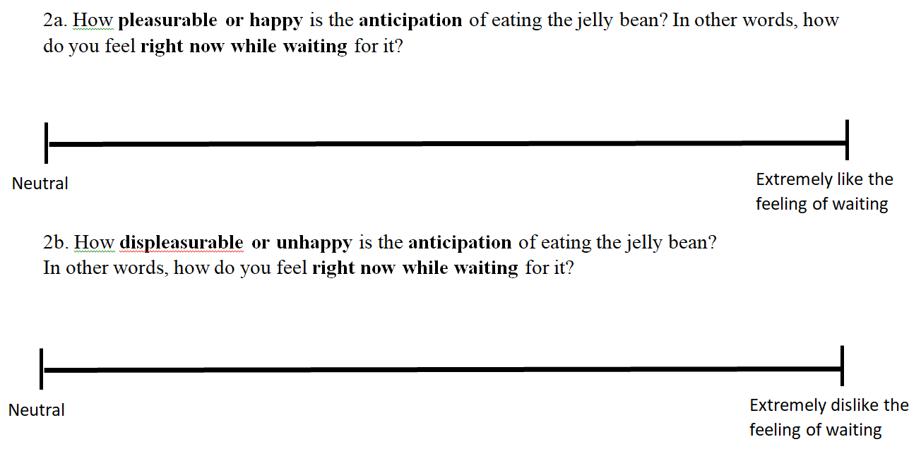
T1 Contemplation utility

Slide 91
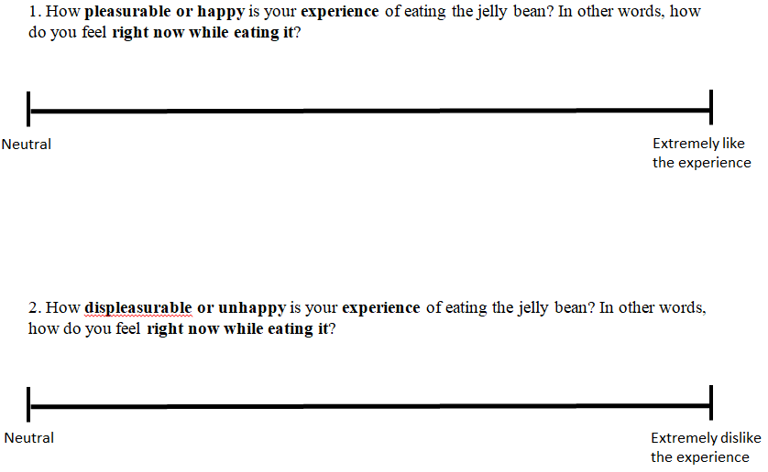
T2 Experience ratings

Slide 92
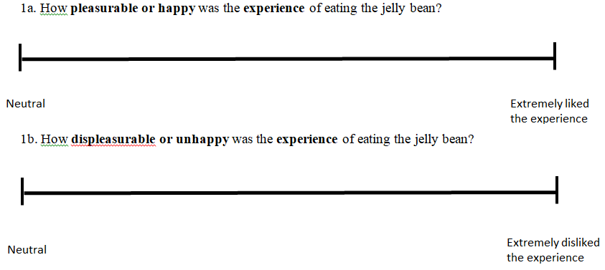
T3 Experience Memory

Slide 93
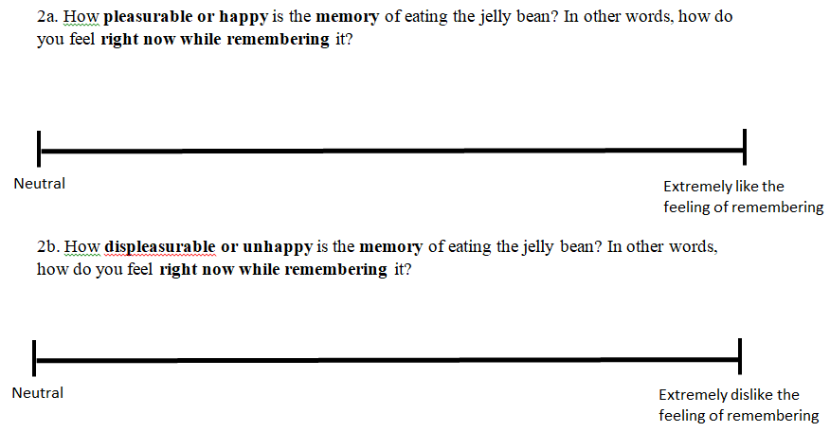
T3 Contemplation Utility

Slide 94
Study 2 Results: Contemplation Utility

Slide 95
Study 2 Results: Contemplation Utility
Flavor:
Good
Bad
Good
Bad
***
***
***
n.s.

Slide 96
Study 2: Experience Utility and Contemplation Utility
Time X valence | A) Contemplation Utility | B) Predicted or recalled experience | Difference between A and B | Correlation between A and B
Future positive | 0.87 | 7.67 | d = 0.76, p <.001 | r = .26
Future negative | 6.31 | 6.75 | d = 0.06, p >.250 | r = .50
Past positive | 6.02 | 7.87 | d = 0.32, p =.030 | r = .67
Past negative | 6.57 | 7.47 | d = 0.03, p >.250 | r = .75

Slide 97
Study 2: Discussion
Contemplation of future positive is a mixed experience
Contemplation of future negative is a negative experience
Contemplation of past positives and negatives are unipolar

Slide 98
Study 3
Alternative explanations

Slide 99
Study 3: Methods
Similar design to Study 1:
  Future vs past
  Positive vs negative
  Money vs hedonic
N = 400 MTurkers

Slide 100
Study 3: Methods
Individually titrate loss aversion. Median results:
  $10 gain = $5 loss
  60 minute massage = 10 second electric shock
A dynamic measure of discounting with greater range and precision (ToAD, Yoon & Chapman 2016)
Measured alternative processes:
  Connection to future/past self
  Thought frequency
Measure and adjusted for utility curvature

Slide 101
Study 3: Financial Utility Curvature

Slide 102
Study 3: Hedonic Utility Curvature
Seconds of electric shock
Minutes of massage

Slide 103
Study 3: Summary of Results
Key results replicated:
  Discount rates
  Contemplation utility
  Mediation
Adjusting for utility curvature: no effect
Connection to distant self & thought frequency:
  Predict discount rates
  Do not explain the sign X tense interaction

Slide 104
Study 4: Uncertainty
Uncertainty could also explain the sign effect:
People are risk averse for both gains and losses in intertemporal choice (Hardisty & Pfeffer, 2017)
The future is unavoidably uncertain
-> sign effect
The past is more certain
-> sign effect is wiped out

Slide 105
Study 4: Methods
201 Mturkers told they will look at 10 photos of puppies or cockroaches (between-subjects), in 5 minutes
“How certain are you that you will see the [puppy] photos?”
“How certain are you about how much you will like or dislike the [puppy] photos? In other words, how certain are you about how you will react to the [puppy] photos?”
“Please consider your uncertainty about the [puppy] photos. How does the uncertainty make you feel?”
0=I strongly dislike the feeling of uncertainty,
100=I strongly like the feeling of uncertainty

Slide 106
Study 4: Methods
Time preference
Contemplation utility
5 min distractor task

Slide 107
Notes:
Image source: https://isotechpest.com/pest-info/cockroaches/american-cockroach

Slide 108
Notes:
Image source: https://allencountyhealth.com/info-about/environmental-health/healthy-homes/pest-control/cockroaches

Slide 109
Notes:
Image source: iStock

Slide 110
Notes:
Image source: https://unsplash.com/

Slide 112
Notes:
Image source: https://unsplash.com/

Slide 113
Study 4: Methods
5 min distractor task
Past uncertainty questions
Past time preference
Past contemplation utility
Need for Cognitive Closure (NFC)
Ambiguity Tolerance (MSTAT)

Slide 114
Study 4 Results: Time Prefs
 | Cockroach | Puppy
Prosp Now Pref | 80% | 52%
Retro Now Pref | 27% | 49%

Slide 115
Study 4 Results: Contemplation
Also: mediation with contemplation utility replicates

Slide 116
Uncertainty Results
The future is more uncertain than the past
  this does not predict time preferences
People weren’t as sure about their reaction to past cockroaches
  this does not predict time preference
We don’t like feelings of uncertainty about puppies or cockroaches
  This predicts contemplation utility
  This does not predict time preferences
Uncertainty attitude (NFC, MSTAT) predicts contemplation utility, but not time preferences

Slide 117
Conclusions
We discount gains more than losses in the future, but not in the past
The sign effect is NOT explained by loss aversion
The sign effect is partly explained by differences in contemplation utility:
  Anticipation of future positive events is a mixed emotion
  Recall of past positive events feels good
  Contemplation of future and past losses always feels bad

Slide 118
Thank you!

